Slide 1
Kubernetes Training Updated 29 January 2020

Slide 2
Kubernetes > Agenda
Big picture
Basics
Objects
Development
Q&A
EKS (Hellman)
Networking

Slide 3
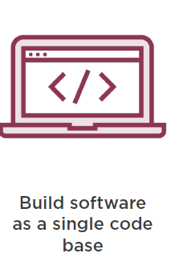
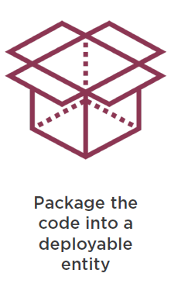
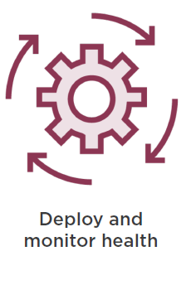
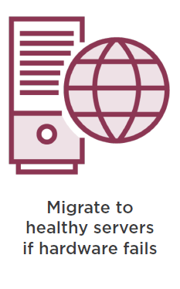
Kubernetes > Big Picture > Traditional Software Development

Slide 4
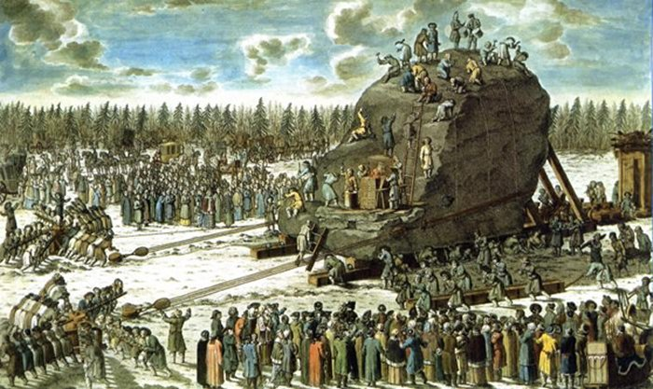
Kubernetes > Big Picture > Traditional Software Release

Slide 5
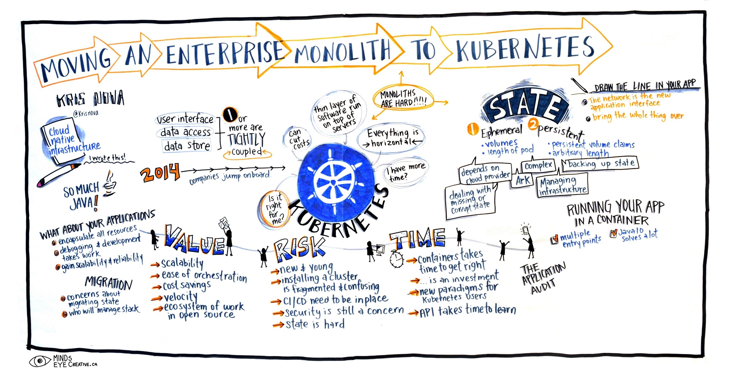
Kubernetes > Big Picture > A better way?

Slide 6
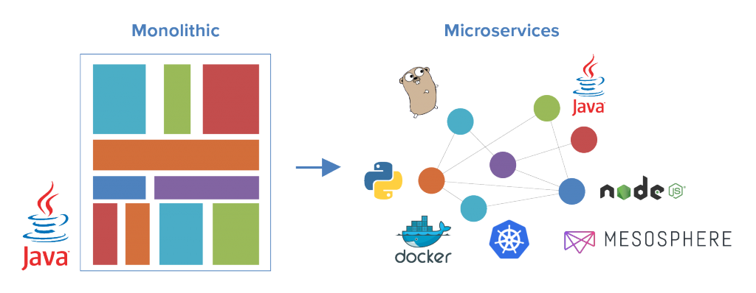
Kubernetes > Big Picture > Monolith-2-Microservices

Slide 7
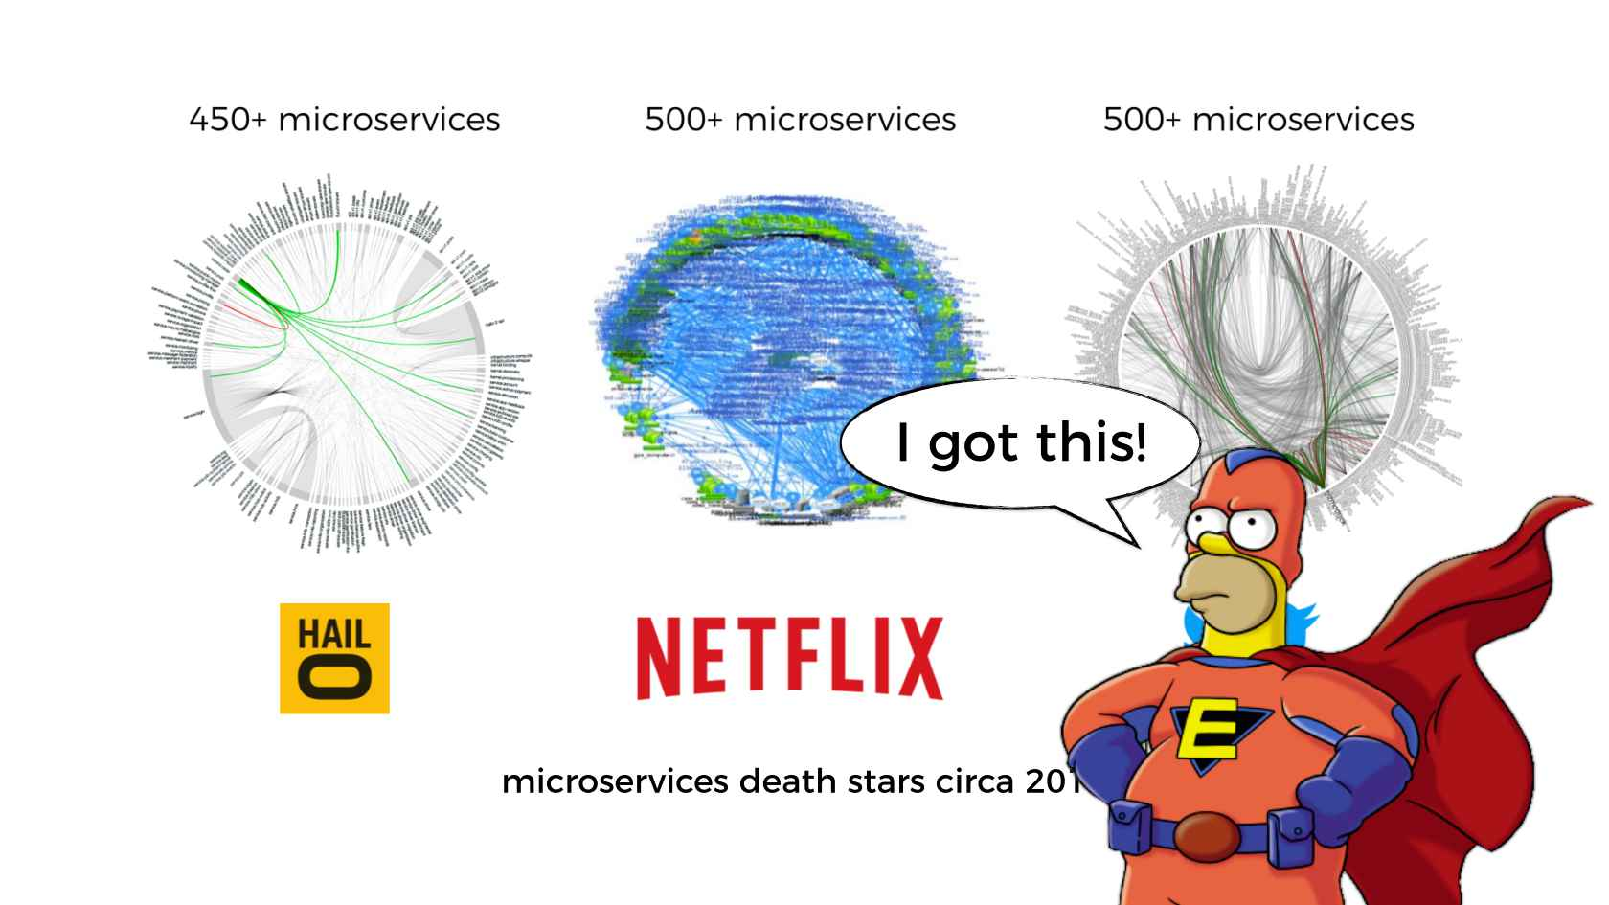
Kubernetes > Big Picture > Microservices

Slide 8
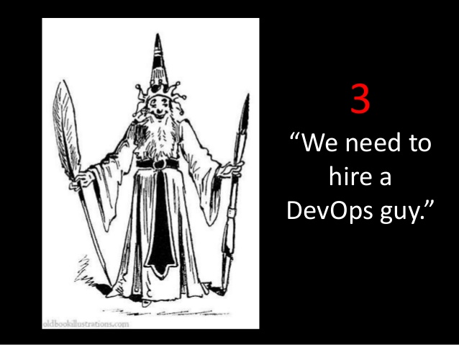
Kubernetes > Big Picture > DevOps

Slide 9

Kubernetes > Big Picture > DevOps > Challenge

Slide 10
Kubernetes > Big Picture > DevOps > Proposal
We need automation, which includes automatic scheduling, automatic configuration, supervision, and failure handling.

Slide 11
Kubernetes > Big Picture > DevOps > Solution

Slide 12
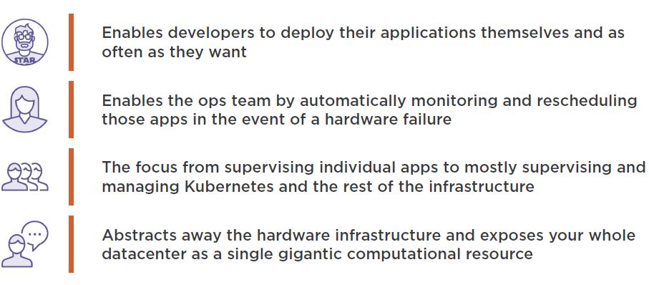
Kubernetes > Big Picture > DevOps > Solution > Benefits

Slide 13


Kubernetes > Big Picture > Q/A

Slide 14

Kubernetes > Basics

Slide 15
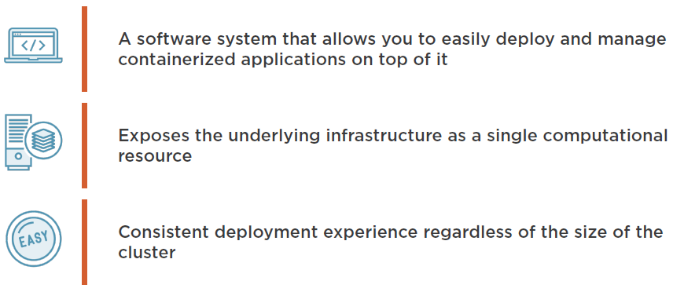
Kubernetes > Basics > What is it?

Slide 16
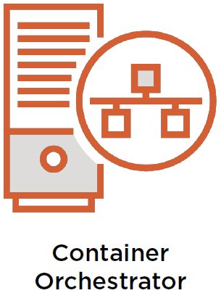

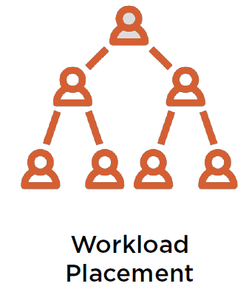
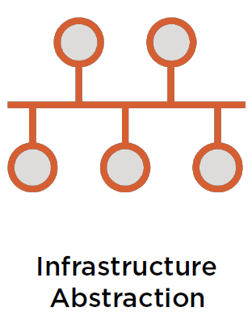
Kubernetes > Basics > What does it do?
A key facet of Kubernetes is workload placement to control how, when and where containers are deployed.
Kubernetes provides desired state configuration in code and leaves it for the platform to ensure that the system meets that desired state.
Kubernetes core responsibility is to orchestrate container-based applications.
Kubernetes provides infrastructure abstraction (networking, storage, etc).

Slide 17
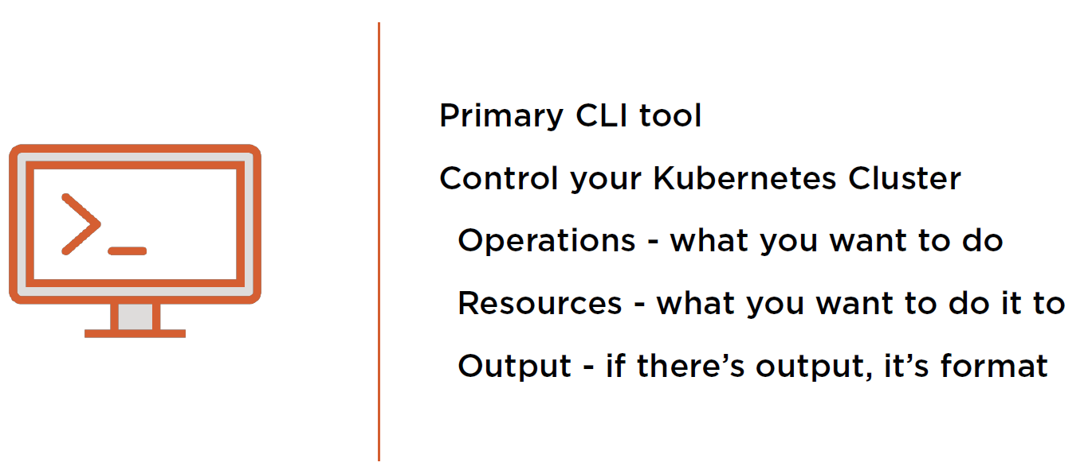
Kubernetes > Basics > kubectl

Slide 18

Kubernetes > Basics > kubectl > Hands-on

Slide 19
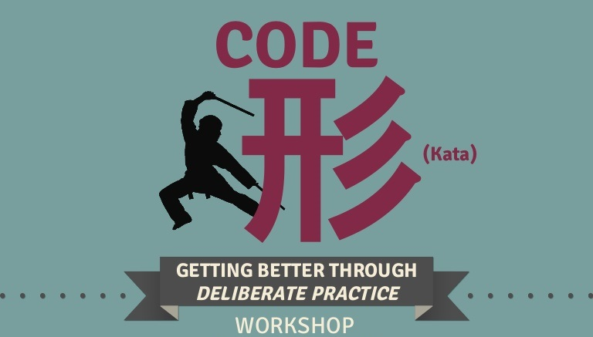
Kubernetes > Basics > kubectl > Code Kata #1

Slide 20
Kubernetes > Basics > kubectl > Q/A

Slide 21
Kubernetes > Basics > Namespaces
Most Kubernetes resources (e.g. pods, services, replication controllers, and others) are in some namespaces. However namespace resources are not themselves in a namespace and low-level resources, such as nodes and persistent volumes, are not in any namespace.
Namespaces can be used to provide quotas and limits around resource usage and have an impact on DNS names that Kubernetes creates internal to the cluster.
If no namespace is specified when interacting with Kubernetes through kubectl, the command assumes you are working with the default namespace, named default.

Slide 22
Kubernetes > Basics > Namespaces > Hands-on

Slide 23
Kubernetes > Basics > Namespaces > Code Kata #2

Slide 24
Kubernetes > Basics > Namespaces > Q/A

Slide 25
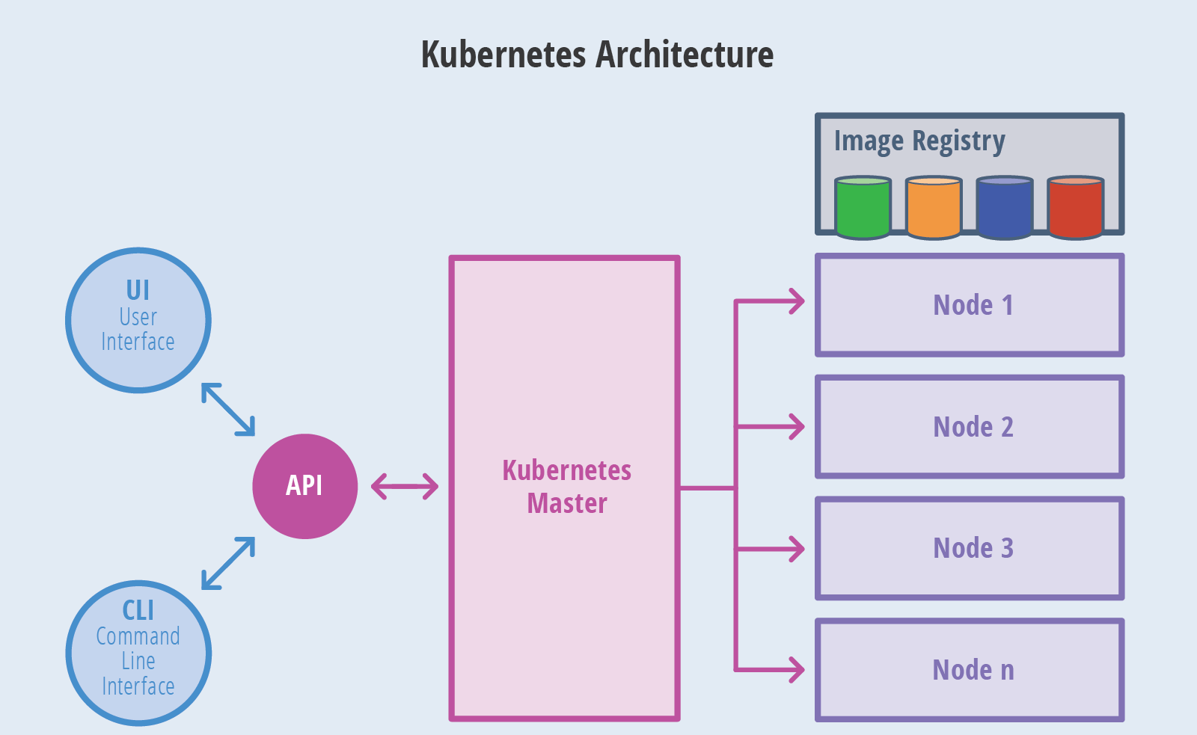
Kubernetes > Basics > Architecture

Slide 26
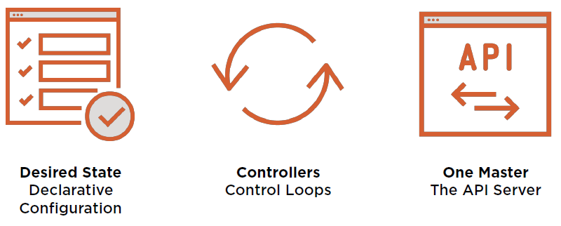
Kubernetes > Basics > Core Principles

Slide 27

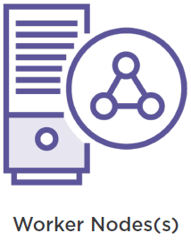
Kubernetes > Basics > Node Types

Slide 28
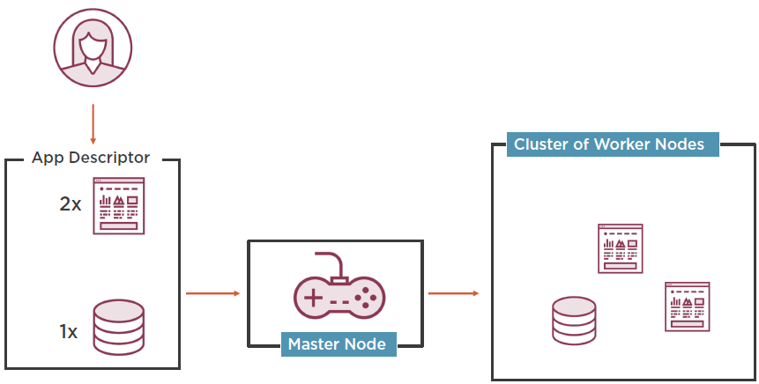
Kubernetes > Basics > System Overview
Developer applies yml manifests.
Worker nodes run application containers and communicates changes back to master node via local kubelet.
Master node looks at the yml manifests and schedules applications for worker nodes.

Slide 29
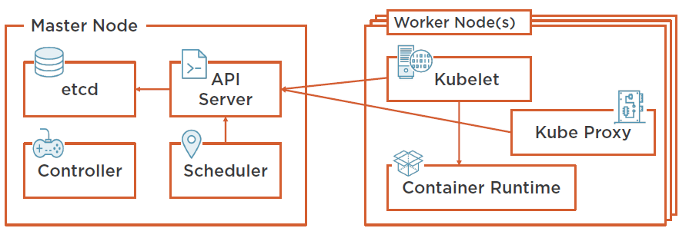
Kubernetes > Basics > Cluster Architecture
Communicates with API server and manages containers.
Load balances network traffic.
Cluster configuration.
RESTful API which acts as a communication hub for the cluster.
Cluster level functions. E.g. replication, tracking worker nodes, handling node failure, etc.
Assigns applications to work nodes.
Docker or rkt.

Slide 30
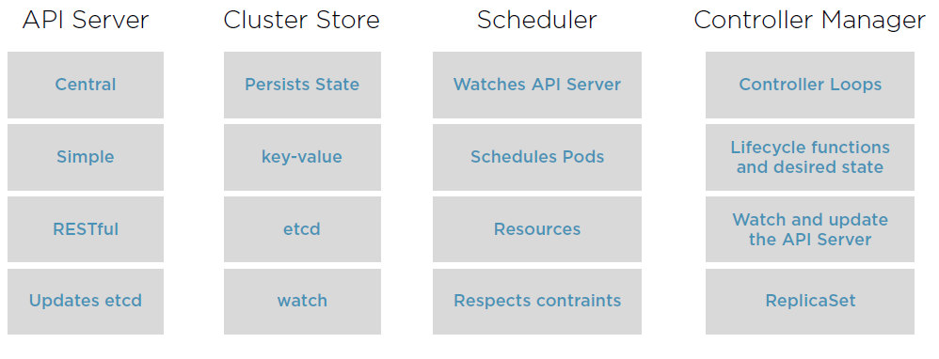
Kubernetes > Basics > Master Node Control Plane Components

Slide 31
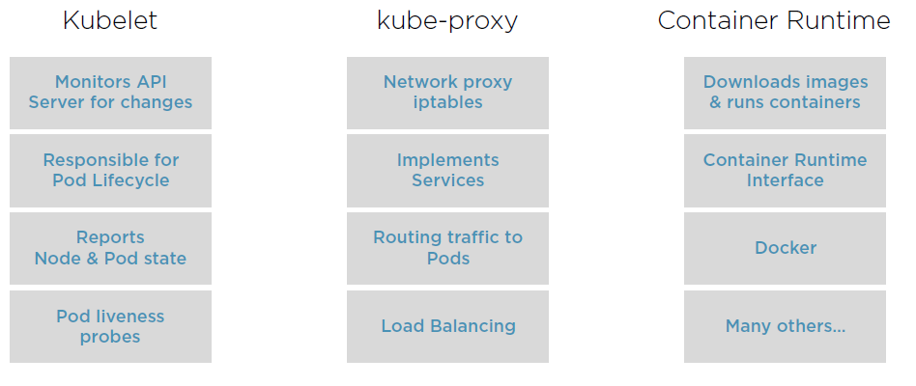
Kubernetes > Basics > Worker Node Control Plane Components

Slide 32
Kubernetes > Basics > Workflow
Package your application into one or more containers.
Push those images to an image registry.
Scheduler schedules containers on available worker nodes.
Post yml manifests to the Kubernetes API Server.
Kubelet instructs worker nodes to download container images.
Kubelet instructs worker nodes to run the containers.

Slide 33
Kubernetes > Basics > Workflow > Hands-on

Slide 34
Kubernetes > Basics > Workflow > Code Kata #3

Slide 35
Kubernetes > Basics > Workflow > Q/A

Slide 36
Kubernetes > Basics > Benefits
Simplifies Application Deployment

Slide 37
Kubernetes > Basics > Benefits
Better Hardware Utilization

Slide 38
Kubernetes > Basics > Benefits
Health Monitoring with Self-Healing
Health Monitoring with Self-Healing

Slide 39
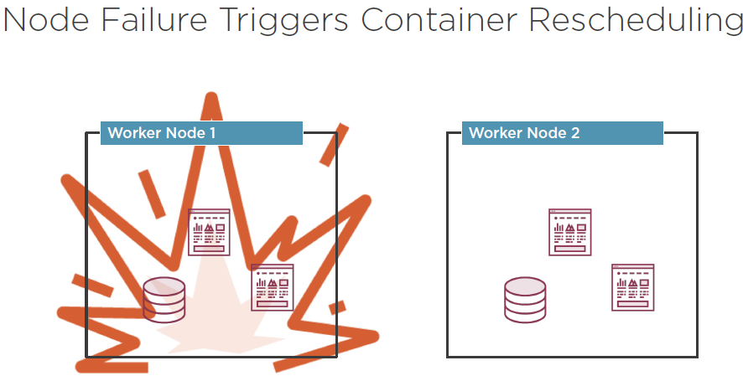
Kubernetes > Basics > Benefits
Health Monitoring with Self-Healing

Slide 40
Kubernetes > Basics > Benefits
Health Monitoring with Self-Healing
Automatic Scaling

Slide 41
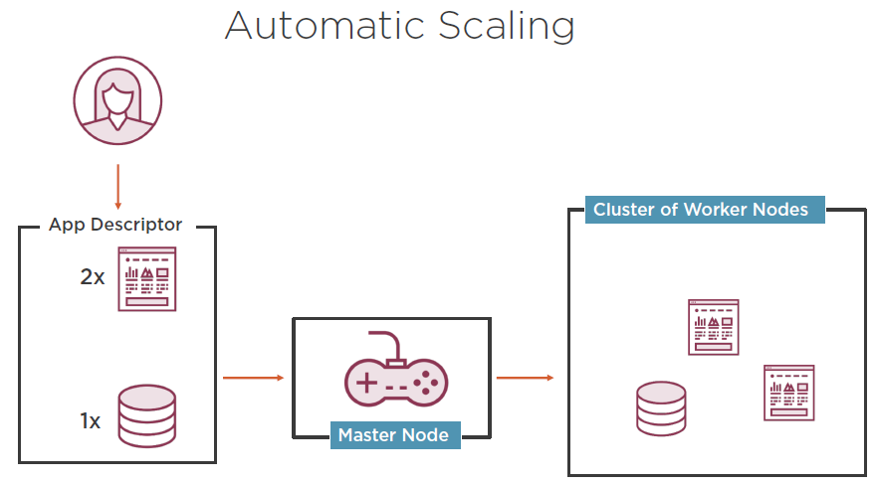
Kubernetes > Basics > Benefits
Health Monitoring with Self-Healing

Slide 42
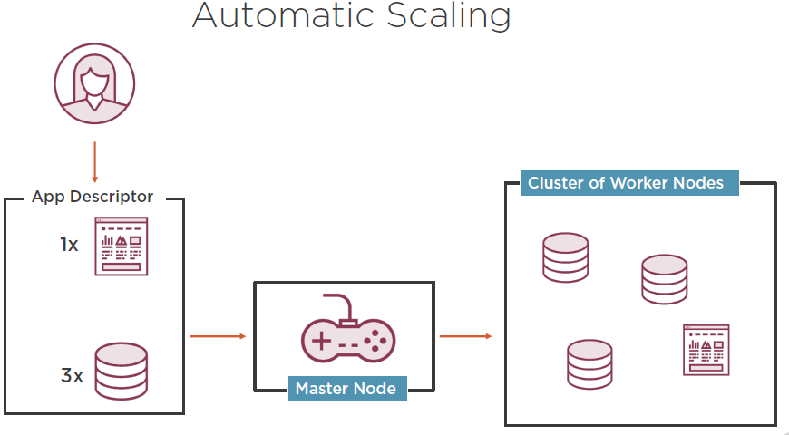
Kubernetes > Basics > Benefits
Health Monitoring with Self-Healing

Slide 43
Kubernetes > Basics > Q/A

Slide 44
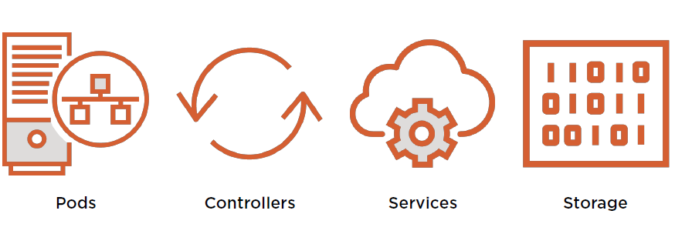
Kubernetes > Objects

Slide 45
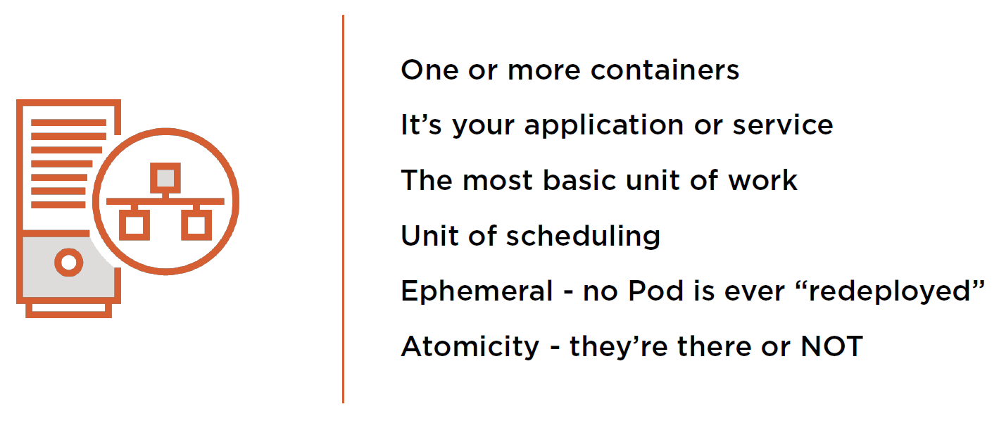
Kubernetes > Objects > Pods

Slide 46
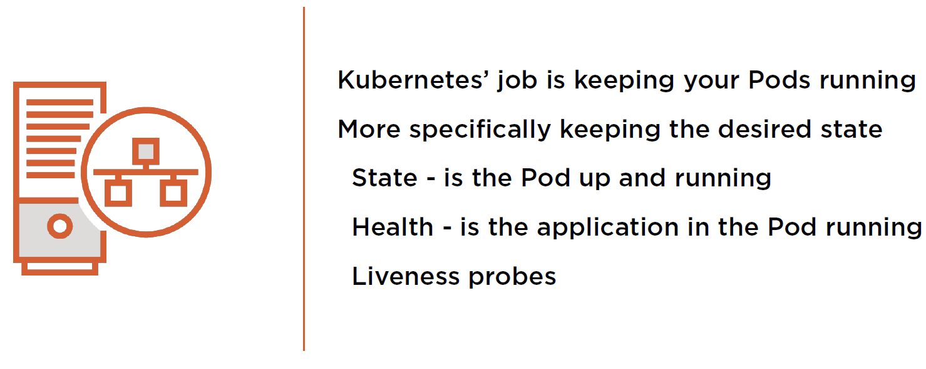
Kubernetes > Objects > Pods

Slide 47
Kubernetes > Objects > Pods > Hands-on

Slide 48
Kubernetes > Objects > Pods > Code Kata #4

Slide 49
Kubernetes > Objects > Controllers
So how does Kubernetes
manage my Pods’ state?

Slide 50
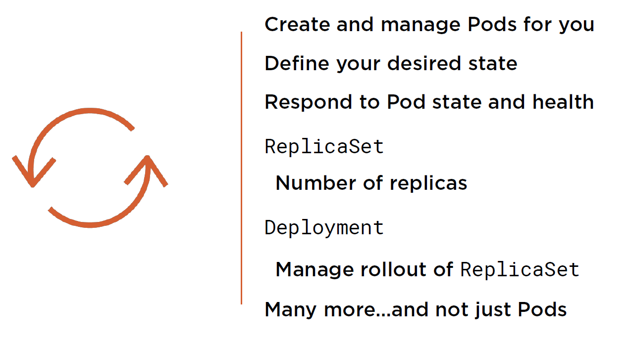
Kubernetes > Objects > Controllers

Slide 51
Kubernetes > Objects > Services
So how does Kubernetes add
persistency to all this ephemerality?

Slide 52
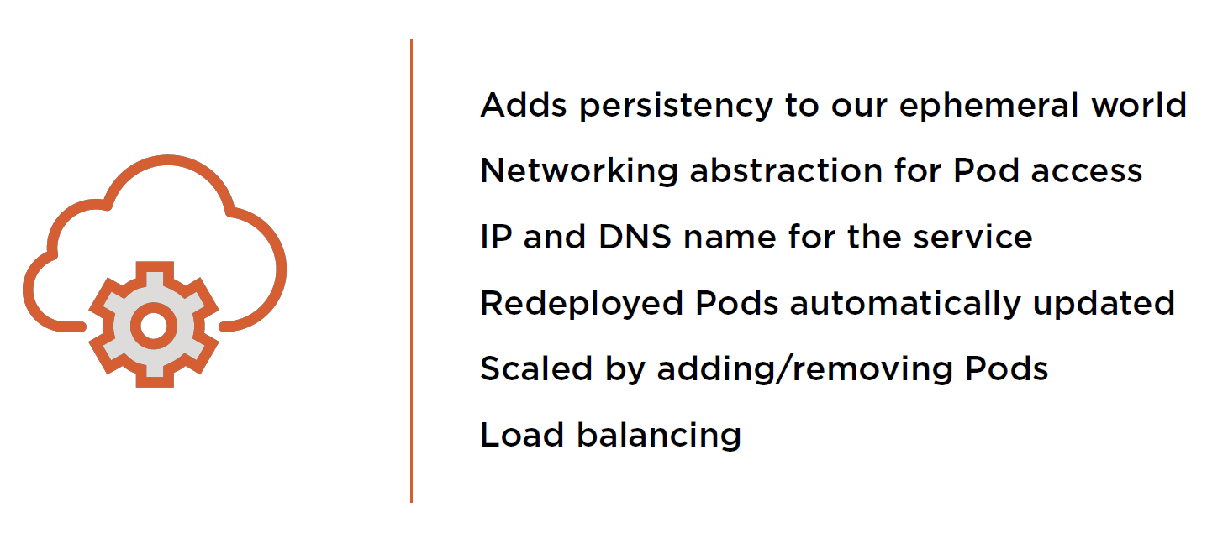
Kubernetes > Objects > Services

Slide 53
Kubernetes > Objects > Services > Hands-on

Slide 54
Kubernetes > Objects > Services > Code Kata #5

Slide 55
Kubernetes > Objects > Storage
What about my data?
Where’s that stored in Kubernetes?

Slide 56
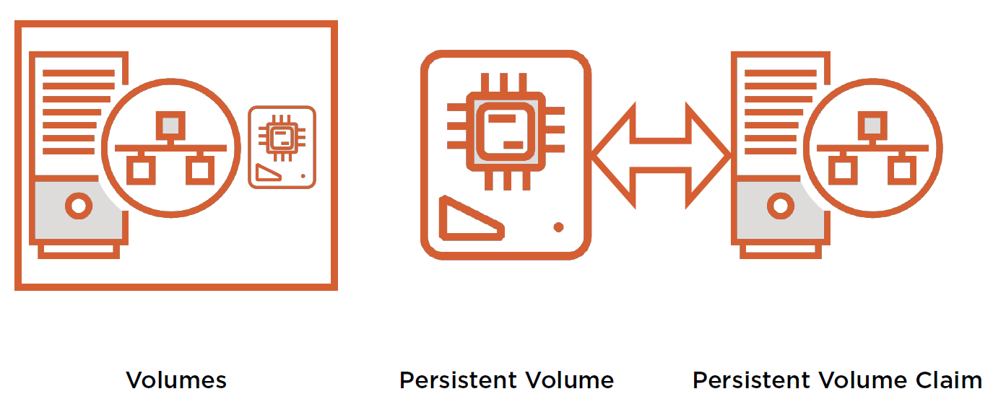
Kubernetes > Objects > Storage

Slide 57
Kubernetes > Objects > Storage > Hands-on

Slide 58
Kubernetes > Objects > Storage > Code Kata #6

Slide 59
Kubernetes > Objects > Q/A

Slide 60
Kubernetes > Networking
So how does Kubernetes connect all these objects?

Slide 61
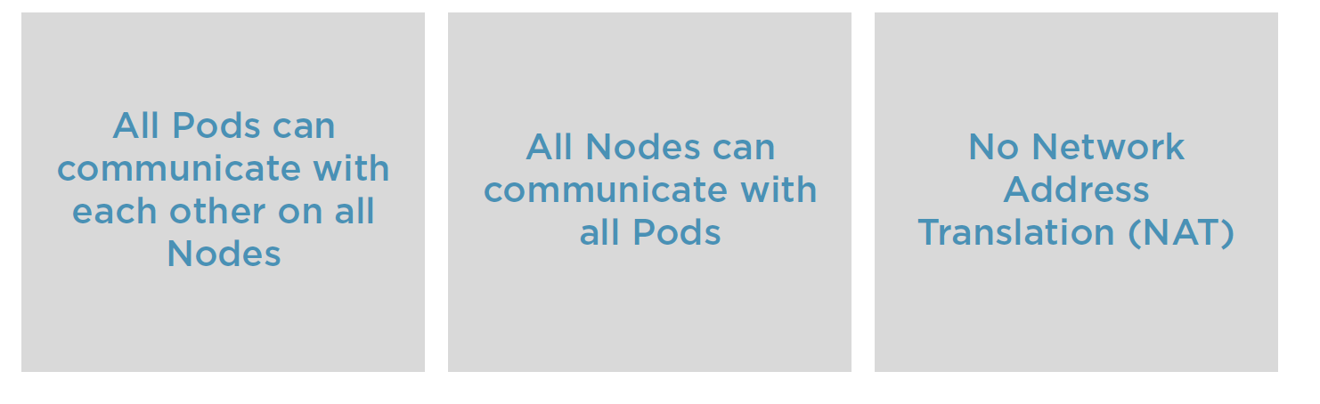
Kubernetes > Networking

Slide 62


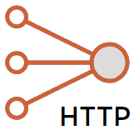
Kubernetes > Networking
Pod
Pod
IP
IP
Bridge
Kube-proxy
Pod
Layer 2 or 3
Inside a Pod.
Pod to Pod within a node.
Pop to Pod on another node.
External service.
Service
localhost
Pod
Kube-proxy
IP

Slide 63
Kubernetes > Networking > Hands-on

Slide 64
Kubernetes > Networking > Code Kata #7

Slide 65
Kubernetes > Networking > Q/A

Slide 66
Kubernetes > Development

Slide 67
Kubernetes > Development > Secrets

Slide 68
Kubernetes > Development > Secrets > Hands-on

Slide 69
Kubernetes > Development > Secrets > Code Kata #8

Slide 70
Kubernetes > Development > ConfigMaps

Slide 71
Kubernetes > Development > ConfigMaps > Hands-on

Slide 72
Kubernetes > Development > ConfigMaps > Code Kata #9

Slide 73
Kubernetes > Development > Resource requirements

Slide 74
Kubernetes > Development > Resource requirements > Hands-on

Slide 75
Kubernetes > Development > Resource requirements > Code Kata #10

Slide 76
Kubernetes > Development > Probes

Slide 77
Kubernetes > Development > Probes > Hands-on

Slide 78
Kubernetes > Development > Probes > Code Kata #11

Slide 79
Kubernetes > Development > Monitoring

Slide 80
Kubernetes > Development > Monitoring > Hands-on

Slide 81
Kubernetes > Development > Monitoring > Code Kata #12

Slide 82
Kubernetes > Development > Debugging

Slide 83
Kubernetes > Development > Debugging > Hands-on

Slide 84
Kubernetes > Development > Probes > Code Kata #13

Slide 85
Kubernetes > Development > Q/A

Slide 86
Kubernetes > EKS

Slide 87
Kubernetes > EKS > Hellman

Slide 88
Kubernetes > EKS > Q/A

